Slide 1
Student Funding Overview
*based on 2025-26 figures

Slide 2
Main costs to university
I want to go to university but have no idea what to take!
Tuition Fee
Living Costs
The tuition fee is the cost of your course and services related to student wellbeing and experience at the university
Rent, Food, Bills, Gym Membership, Phone Contract, Other

Slide 3
Tuition Fee
Most universities charge a tuition fee of £9535
A Tuition Fee Loan is available to cover this fee
The Tuition Fee Loan is paid directly to your university

Slide 4
Tuition Fee
Generally, full Tuition Fee Loan support is available for your first higher education qualification, plus one extra year should you need it:
=
+
Extra
Year
4
Years
Full
Support
25/26
26/27
27/28
Example based on a standard 3-year full-time degree
Note: If you change course or need more than one extra year, this may affect the number of years you can get a tuition fee loan

Slide 5
Living Costs
I know exactly what I want to do but have no idea how to get there!
A Maintenance Loan is available to help students with their living costs
Household income
Where you live whilst studying
The Maintenance Loan is means-tested
Your Maintenance Loan is paid directly into your bank account each term

Slide 6
The Maintenance Loan
£
£8,877
Parental Home Rate:
Live at home while they study
*Maximum loan amount available
£
£10,544
Elsewhere Rate:
Live and study away from home, outside London
*Maximum loan amount available
£
£13,762
London Rate:
Live and study away from home, in London
*Maximum loan amount available

Slide 7
c
Maintenance Loan: what funding could you access?
Household Income | Home | Elsewhere | London
£25,000 & under | £8,877 | £10,544 | £13,762
£35,000 | £7,387 | £9,038 | £12,231
£45,000 | £5,897 | £7,532 | £10,700
£55,000 | £4,407 | £6,026 | £9,168
£65,000 | £3,907 | £4,915 | £7,637
£75,000+ | £3,907 | £4,915 | £6,853
Maintenance Loan is subject to means testing

Slide 8
Student Finance: How Do I Apply?
Apply online for funding from Student Finance England: www.gov.uk/studentfinance

Slide 9
Student Finance England: What Can I Apply For?
Tuition Fee Loan
Maintenance Loan
Applications for both loans can be made on the Student Finance England website.

Slide 10
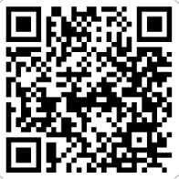
Student Finance England: Eligibility
To qualify for FULL financial support from Student Finance England the student must meet three main criteria:
1. You are a UK National, Irish citizen or have ‘Settled Status’
3. You do not already hold an honours degree. There are some exceptions to this
2. You normally live in England and have been living in the UK, the Channel Islands or the Isle of Man for 3 years in a row before the first day of the start of your course
EU students can apply for maintenance loan support if they have been a resident in the UK for five years or more.
Don’t meet the criteria above?
A list of full eligibility and entitlement criteria can be found using the QR code

Slide 11
Student Finance England: What do I need to apply?
Students
Parents/ Guardians
Passport, Birth Certificate or other identity and residency evidence information (This includes valid EUSS Share Codes for EU, EEA and Swiss nationals)
UK bank account details
National Insurance Number
National Insurance numbers for income verification (from the prior tax year)
Details of other child dependants

Slide 12
Student Finance England: Application Timeline
MARCH
MAY
SEPTEMBER
Applications Open
Deadline
Enrol at University

Slide 13
c
Student Finance Repayments
You won’t have to make repayments until your income is over the set threshold, which is £25,000 a year
You will be required to start repaying from the April after completing your course
You’ll repay 9% of any income earned over the £25000, the deductions will be made from your pay through the tax system
If your income drops below the £25000, your repayments will stop. Any outstanding balance will be cancelled after 40 years

Slide 14
c
Repayment Timeline
Do NOT repay loan
Earning less than £25,000 = no repayment
University
World of Work
Repayments Begin: April after completing the course and earning more than £25,000
40 years after completing your course, all loans are written off

Slide 15
c
Student Finance: What could I repay?
Income each year before tax | £25,000 | £35,000 | £40,000 | £45,000
9% will be deducted from | £0 | £10,000 | £15,000 | £20,000
Monthly Repayments (Approximately) | £0 | £75 | £112 | £150

Slide 16
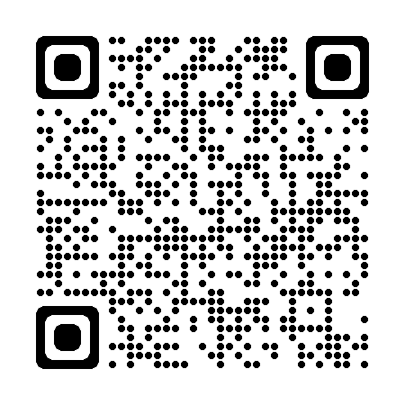
c
Government Grants Available
Parents Learning Allowance
Disabled Students Allowance​ (DSA)
You can apply for DSA from Student Finance England before you start your course. This is applied to separately from your maintenance/tuition fee loan.
Disclosure​
Disclosing a disability on your application does not impact the outcome. It is only asked so support can be recommended to you.
It can take up to three months to get your DSA support in place so you should apply for it as soon as you have applied for a course.
Adult Dependant Grant
Childcare
Grant

Slide 17
Hallam Bursaries and Scholarships
Extra sources of financial support are available in the form of university-specific scholarships and bursaries.
Unlike student loans, typically you don’t have to pay these back.
Student Success Scholarships
Care Leaver Bursary
Placement Bursary
Performance Athlete Support Programme

Slide 18
NHS Learning Support Fund
NHS Learning Support Fund (LSF) is funding to support eligible healthcare students.
Nursing & Midwifery
Allied Health
Social Care
Nursing (Adult)
Nursing (Child)
Nursing (Mental Health)
Learning Disability Nursing & Social Work
Midwifery
Occupational Therapy
Physiotherapy
Diagnostic Radiography
Operating Department Practice
Paramedic Science
Radiotherapy and Oncology
Social Work
Reduced funding rate.
Apply from second-year of study
You can apply for a Training Grant of £5,000 per academic year, or a pro rata amount for part-time students.

Slide 19
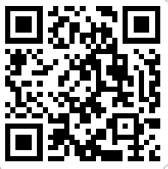
Managing Your Money: Before University
Prepare to bring money with you, your maintenance loan is normally paid on the first day of your course but can take up to five days after you enrol to be paid to you.
Talk to your bank about setting up a student bank account – different banks have different offers e.g. free rail card, cash incentives, 0% interest on overdrafts
Plan and budget
Is a useful website to help you budget

Slide 20
Managing Your Money: At University
Part-time work
Students can work an advised 12-15 hours per week without studies being affected
Remember:
Your maintenance loan is paid in three instalments throughout the year
Budget
Is a useful website to help you budget

Slide 21
FIND OUT MORE...
OPEN DAYS
LIVE CHAT
SOCIAL MEDIA
Check Sheffield Hallam’s website for our latest open day dates:​
www.shu.ac.uk/visit-us
Chat to our students and staff to find out more about life at Sheffield Hallam
Follow us @shuoutreach on Instagram for top tips, information and competitions

Slide 22
Thank you
The slides from this talk will be posted on our college website – we’ll text out a link when they’re available to view
Other talks available this evening
Don’t forget to visit out university and employer fair in the Sports Hall
Our visitors are available until 7.30 pm
1730
1800
1830
1900

