Slide 1

An Introduction to Apprenticeships
and the Labour Market

Slide 2

Why consider an apprenticeship?
An apprenticeship offers the chance to:
Earn while you learn
Practical and relevant experience
Guidance and support
Strengthen your CV
Build your contacts
Gain a nationally recognised qualification…
…and avoid student debt
Progress within a business

Slide 3

Types of Apprenticeship
Degree Apprenticeships
Sometimes referred to as a L6 apprenticeship
Qualification gain is equivalent to a degree
Higher Apprenticeships
Sometimes referred to as a L4 (or L5) apprenticeship
Qualification gained is on same level as first year (or first two years) of a degree
Advanced Apprenticeships
Sometimes referred to as a L3 apprenticeship
Qualification gained is on same level to studies at New College, eg A-levels or BTEC Nationals
For all of these, study is usually done on a ‘block release’ or ‘one day per week’ format, but it depends on the employer

Slide 4

Where can I do an apprenticeship?
Apprenticeship vacancies are advertised throughout the year
Whilst some higher and degree apprenticeships are available locally, they are usually advertised for cities such as Sheffield, Leeds and York
It is not unusual for students to commute (or even move elsewhere) in order to do a higher or degree apprenticeship
This is why higher and degree apprenticeships often have higher rates of pay or benefits packages that offer subsidised accommodation

Slide 5

Rates of Pay
Yearly Minimum Wage (37.5 hours per week)
from April 2024
Apprentice £14,723
16 to 17 years old £14,723
18 to 20 years old £19,500
21 year old and above (National Living Wage) £23,809
Average Yearly Graduate Starting Salary
UK, 2024 approx £32,000
Yorkshire and the Humber, 2024 approx £26,545
https://luminate.prospects.ac.uk/graduate-salaries-in-the-uk
Students often look at the rate of pay and say it is lower than they would expect – but remember, the employer is also paying for the cost of the qualification
Higher and degree apprenticeships (L4, L5 or L6) can offer pay in the region of £16000 to £25000
Advanced (L3) usually pay in the region of £11000 to £15000 per year
The key thing to remember is that you’ll usually be offered a higher rate of pay when you qualify
Notes:
Rates – gov.uk
Graduate – institute of student employers

Slide 6

Applying for Apprenticeships
Apprenticeship vacancies with a July/Aug/Sept 2026 start will be advertised throughout the year, though will usually become more frequent from October 2025 onwards
Therefore, students will need to check vacancies each week and apply as appropriate
The process after the initial application differs depending on the type of employer:
  Large companies – multiple stages (online testing, video interview, assessment day, final interview)
  Smaller companies – one or two stages (eg video interview, final interview)

Slide 7
Applying for Apprenticeships
Be careful of… the apprenticeship that isn’t an apprenticeship
Some job adverts may use the term ‘apprenticeship’ but with very little details of the qualification available and vague information about the rates of pay
We would encourage students to make sure they know what the progression routes are!

Slide 8
The local and national labour market

Slide 9
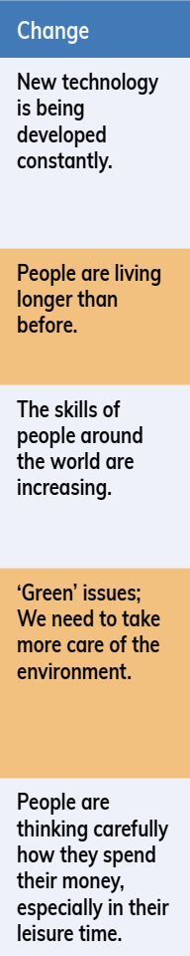
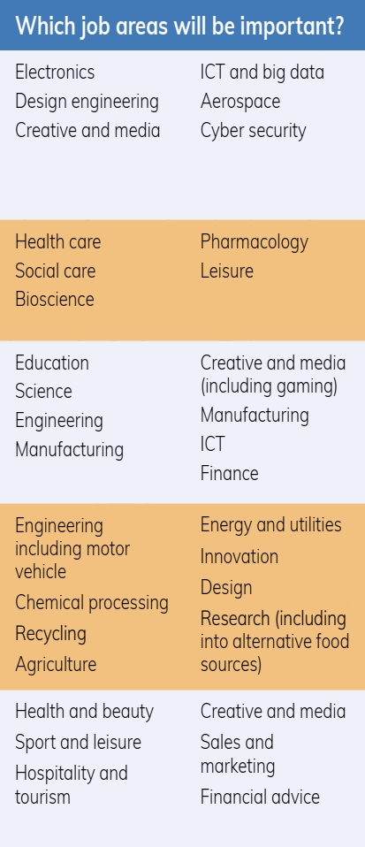
National Picture
The Labour Market is changing

Slide 10


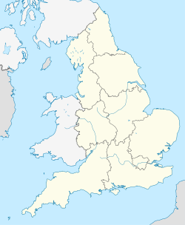




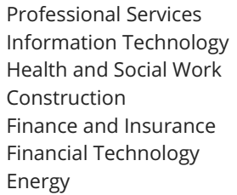
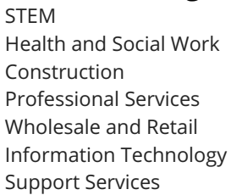


Slide 11


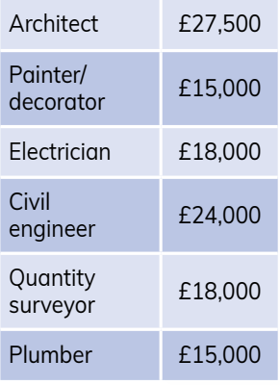
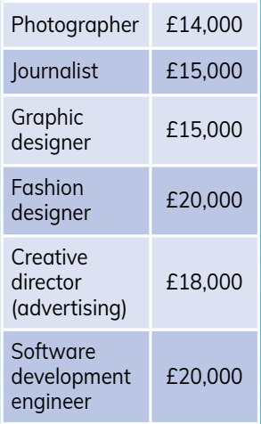
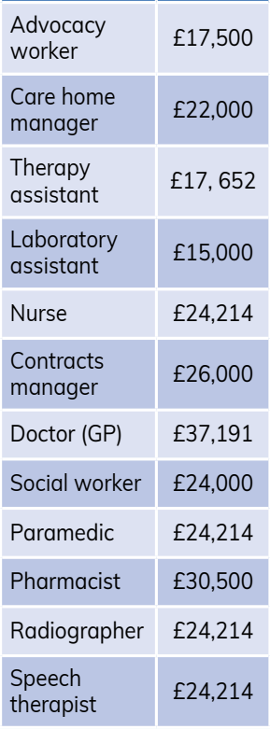

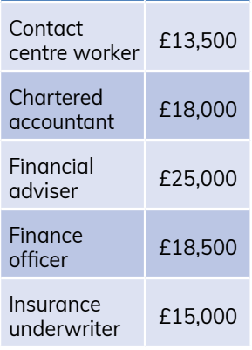


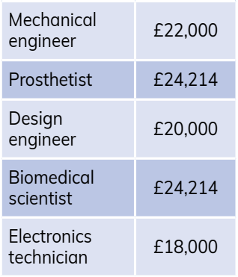
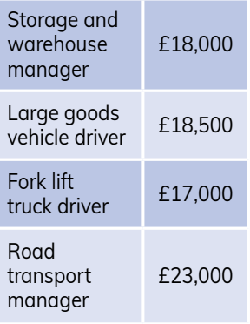
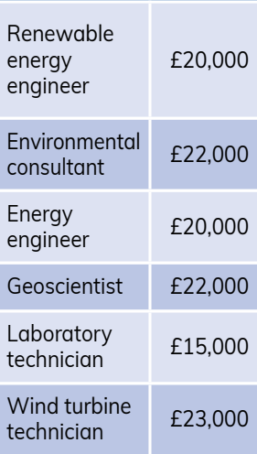


South Yorkshire MCA
Popular Sectors

Slide 12
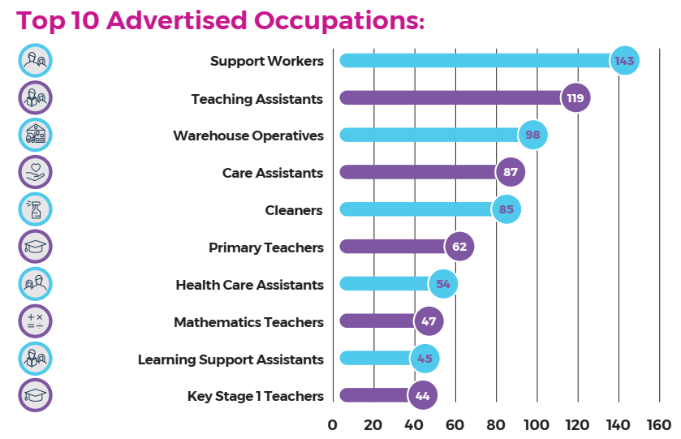
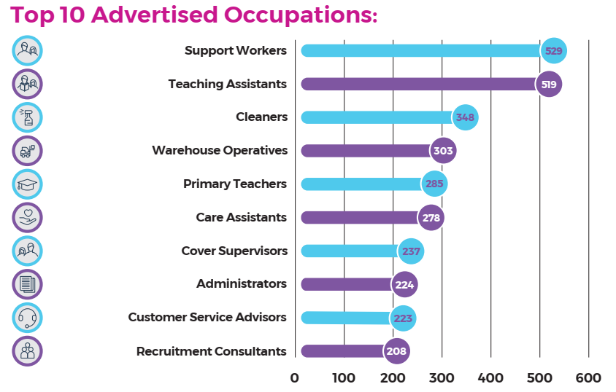
Doncaster South Yorkshire

Slide 13
Doncaster South Yorkshire
Job roles / progression routes that are most relevant to New College students, given their skills and qualifications

Slide 14
Doncaster South Yorkshire
Job roles / progression routes that are most relevant to New College students, given their skills and qualifications
Key message
The vast majority of recent vacancies have been in education or health and social care, so to secure apprenticeships or employment outside of these sectors, students may need to cast their net wider than both Doncaster and South Yorkshire

Slide 15
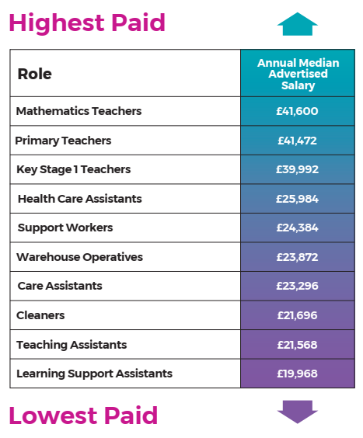
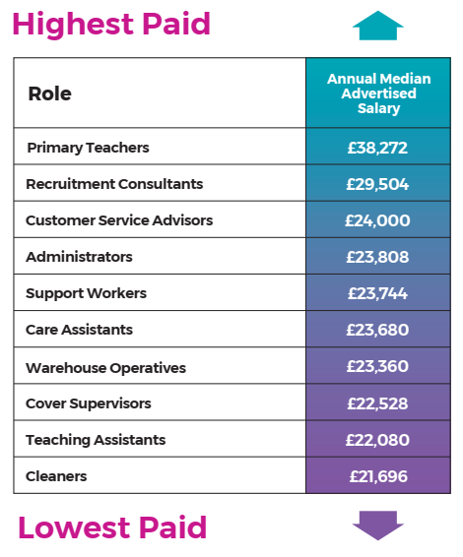
Doncaster South Yorkshire
(Feb 2024)

Slide 16
Doncaster South Yorkshire
Job roles / progression routes that are most relevant to New College students, given their skills and qualifications

Slide 17
Doncaster South Yorkshire
(Feb 2024) (Feb 2024)
Job roles / progression routes that are most relevant to New College students, given their skills and qualifications
Key message
The recent vacancies with the highest rates of pay have also been in education or health and social care, so to secure apprenticeships or employment outside of these sectors, again students may need to cast their net wider than both Doncaster and South Yorkshire

Slide 18
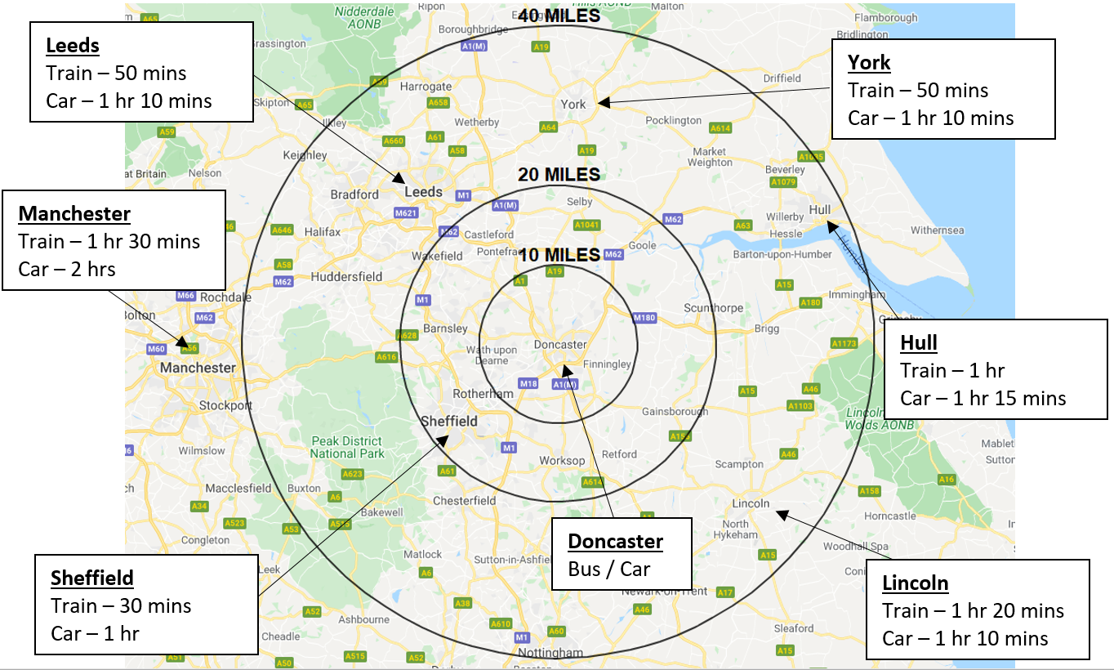
Looking further afield…

Slide 19
Key Points
Apprenticeships
The Local Labour Market

Slide 20
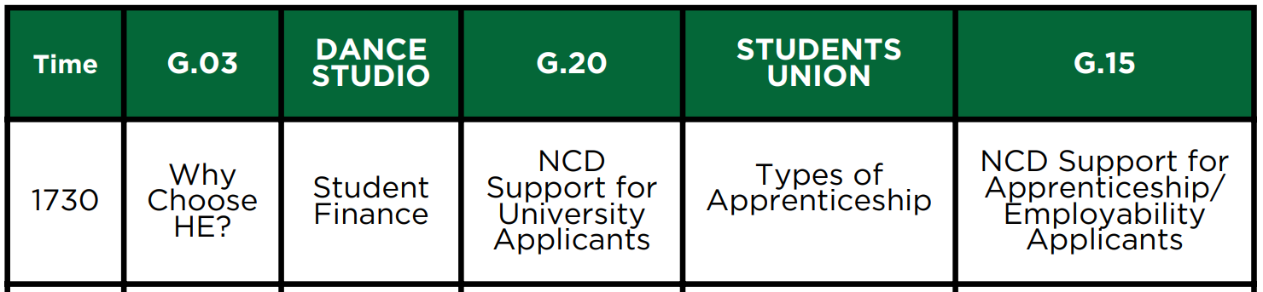
Thank you
The slides from this talk will be posted on our college website – we’ll text out a link when they’re available to view
Other talks available this evening
Don’t forget to visit out university and employer fair in the Sports Hall
Our visitors are available until 7.30 pm
1730
1800
1830
1900

