Slide 1

How does New College support students applying for Apprenticeships and Employment?

Slide 2

Applying for Apprenticeships
Apprenticeship vacancies with a July/Aug/Sept 2027 start will be advertised throughout the year, though will usually become more frequent from October 2026 onwards
Therefore, students will need to check vacancies each week and apply as appropriate
The process after the initial application differs depending on the type of employer:
  Large companies – multiple stages (online testing, video interview, assessment day, final interview)
  Smaller companies – one or two stages (eg video interview, final interview)
Therefore, our support is centred around providing students with the knowledge, skills and practice that they need to make competitive applications

Slide 3

Applying for Employment
Some students do secure employment that isn’t an apprenticeship
This is fine – though we would always encourage students to secure positions aimed at college / 6th form leavers rather than ordinary school leavers so that they are in a stronger position to progress
Some students opt to increase their hours at their current part-time job because they know there is the possibility of progression
Again, our support is centred around providing students with the knowledge, skills and practice that they need to make competitive applications

Slide 4

Support so far…
Tutorial programme
Advantages and disadvantages of apprenticeships
Types of apprenticeships
How to strengthen applications
Subject-specific encounters
Trips and visits
Visiting speakers (virtual and face-to-face) in lessons
Careers and HE Talks
From a range of employers and apprenticeship providers
Individual Guidance
Progress Tutor
1-to-1 Careers Appointments

Slide 5

Next steps…
Tutorial programme
UCAS Hub
Typical application processes for apprenticeships/employment
Work Experience Day – 2nd July
Work experience
Over summer…
Write a ‘Skills and Experiences’ statement
Complete the ‘Personal Details’, ‘Education’ and ‘Employment’ section of the UCAS form

Slide 6

Support in Year 13…
Focused support for apprenticeship and employment applicants
Autumn Term tutorials support students with:
Searching for and applying for vacancies
Reflecting on skills and experiences
Refining and redrafting supporting statements / questions for applications
Developing their online presence
Considering responses to common interview questions
Practising psychometric tests

Slide 7
Support in Year 13…
In the Spring Term…
Mock Interview Practice (visiting employers)
Job club
Employer events
Apprenticeship and employment fairs
Teams group for vacancies

Slide 8


















The Outcome…
In 2025, 29% of our leavers progressed onto employment or apprenticeships, rather than university.

Slide 9
Work Experience
All students can complete up to two weeks worth of work experience in college time
They can arrange their own placement or we can help them to find a placement
If students arrange their own placements, they must speak to Naiomi Grant or Anna Collins (work experience co-ordinator) at least two weeks before they are intend to go out on placement
If students would like our help in finding a placement, they can speak to Anna or Naiomi (Mon-Wed in the Careers Office)
Naiomi also has a stand in the Sports Hall this evening.

Slide 10
Students applying for the Armed Forces, Police and Fire Service

Slide 11

Armed Forces
For students interested in the Armed Forces, we would encourage them to visit their
local recruitment office as soon as possible, if they haven’t already
For students interested in the Police, we would encourage them to regularly check the recruitment websites of local police forces, so that they do not miss upcoming opportunities. Doncaster is close to lots of neighbouring police areas:
  South Yorkshire Police
  West Yorkshire Police
  Nottinghamshire Police
  Lincolnshire Police
  North Yorkshire Police
  Humberside Police
  British Transport Police
We would also encourage students to apply for Professional Policing courses at
university as apprenticeship vacancies are few and far between
Students should also consider joining as a Special Constable when they are 18, particularly if they are set on waiting for an apprenticeship vacancy and are unsuccessful this year
Police

Slide 12
Fire Service
For students interested in the Fire Service, we would encourage them to regularly check the recruitment websites of local fire and rescue services, so that they do not miss upcoming opportunities. Doncaster is close to lots of neighbouring fire and rescue areas:
  South Yorkshire Fire and Rescue
  West Yorkshire Fire and Rescue
  Nottinghamshire Fire and Rescue
  Lincolnshire Fire and Rescue
  North Yorkshire Fire and Rescue
  Humberside Fire and Rescue
Students should also consider joining as a Volunteer Firefighter when they are 18, whilst they wait for opportunities to arise

Slide 13
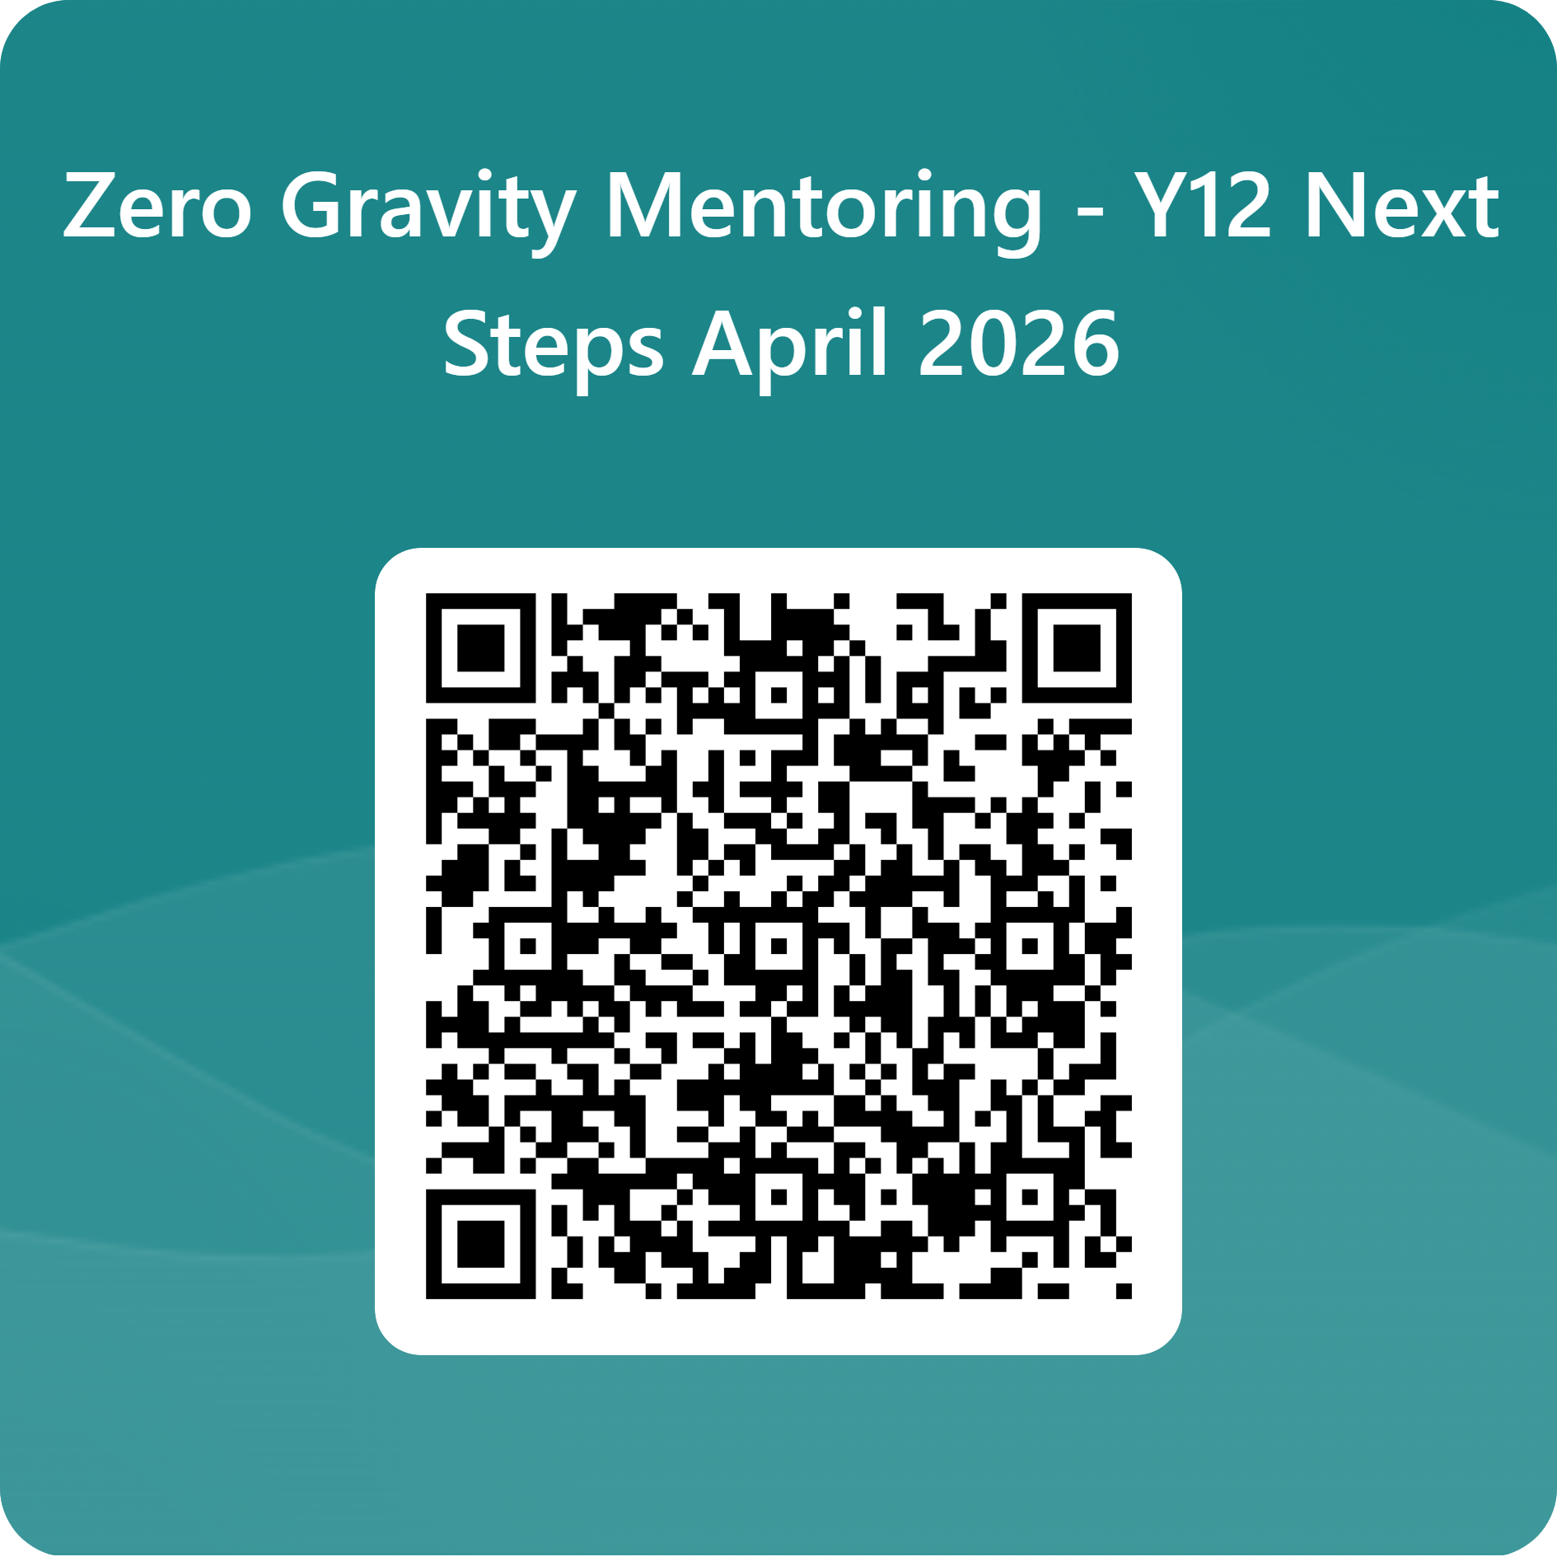


New College Doncaster x
Zero Gravity
Unleashing NCD’s student potential through Zero Gravity’s free membership
1-2-1 mentor, opportunity to be matched with a mentor at HSBC covering areas including cybersecurity, HR, engineering, financial services and operations
Access to a busy schedule of live masterclasses, led by experts in their field
Membership in their 20,000+ strong Community, where like-minded students support each other to defy the odds

Slide 14
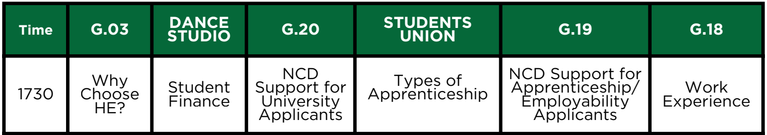
Thank you
The slides from this talk will be posted on our college website – we’ll text out a link when they’re available to view
Other talks available this evening
Don’t forget to visit out university and employer fair in the Sports Hall
Our visitors are available until 7.30 pm
1730
1800
1830
1900
1830 only

