Slide 1







Own your budget:
Student Finance at University
*based on 2025-26 figures

Slide 2


Main costs to university
Tuition Fee Loan
Maintenance Loan
Tuition Fee
Living Costs
March
Student Finance Opens
May
Student Finance Deadline
September
Enrol to university
Notes:
So let's talk about the main costs of university.
These are normally split into two categories.
First you have your tuition fees that are covered by your tuition fee loan, then you have your living costs that are covered by your maintenance loan. We'll get more in depth to these separate costs shortly.
Now we're not going into too much detail about the application process of student finance today, but here's a brief timeline of how it's normally ran. March is when student finance applications typically open and you apply for this online at the Student Finance England website. Ideally you would apply for this by May when the student finance deadline looms, ready for it to be sent out to you once you enrol at your chosen university. If you want to find out more about Student Finance head to the student finance england website for more details.

Slide 3
The tuition fee is the cost of your course and services related to student wellbeing and experience at the university
Tuition Fee
Notes:
So let's look at tuition fees, so tuition fee covers the cost off your course and all the services come alongside it to give you the best experience at university.

Slide 4
Most universities will charge a tuition of £9790 for 2026/27
A Tuition Fee Loan is available to cover this fee
The Tuition Fee Loan is paid directly to your university
Tuition Fee
Notes:
Most uni's charge a tuition fee currently at £9535, which seems like a lot of money. However don't worry your tuition fee loan is available to cover this loan in its entirity and you never actually see this money, your loan gets paid directly to your university, so you don't need to manage any funds towards your tuition, you just have to apply for it each year that you attend uni.

Slide 5
Living costs refer to your everyday expenses while studying at university, including things like accommodation, food, travel, and other essentials you need to support your lifestyle and learning. This is covered by the Maintenance Loan.
Living costs
Notes:
Now let's look at the living costs. Your living costs refer to all the funds that help support you while you're at university including your housing costs, foodd, bills, travel etc.

Slide 6
A Maintenance Loan is available to help students with their living costs
The Maintenance Loan is means-tested
Your Maintenance Loan is paid directly into your bank account each term
Living costs
So how much maintenance loan do I receive?
Notes:
There is a loan available to help with your living costs known as a maintenance loan. This isn't as straight forward as your tuition fee as there are some aspects that determine how much you will receive to cover your living costs such as the fact they are means tested. We'll go over this in the next couple of slides. This is paid directly into your account that you provide to student finance england. Please be aware that your maintenance loan is paid in three instalments of each year you apply for your loan. You will receive roughly around the following:
1st instalment – End of September, beginning of October
2nd instalment – start of January
3rdinstalment – start of April
So how much maintenance loan will you receive, let's look into this:

Slide 7

The Maintenance Loan
£
£9,118
Parental Home Rate:
Live at home while they study
*Maximum loan amount available
£
£10,830
Elsewhere Rate:
Live and study away from home, outside London
*Maximum loan amount available
£
£14,135
London Rate:
Live and study away from home, in London
*Maximum loan amount available

Slide 8













Hallam has 14 different properties with various price points starting below the national average!
Accommodation
Average cost for UK student accommodation - £166 pw
(The complete university guide, 2024)
Notes:
So according to a recent study the average cost for uk student accommodation is £166pw.
We're quite fortunate in Sheffield to have very affordable accommodation that is well under the average amount with some of our most expensive accommodation starting at £165

Slide 9
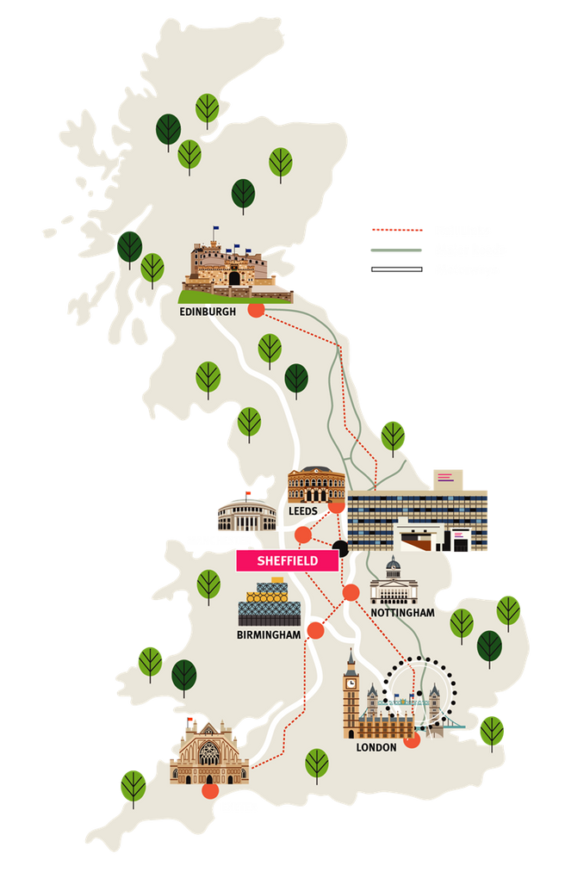



Sheffield’s central location makes it an ideal hub for transport, offering excellent connections across the UK.
Travel
Average cost for uk student travel - £65 pw
(SaveTheStudent.Org, 2024)

Slide 10
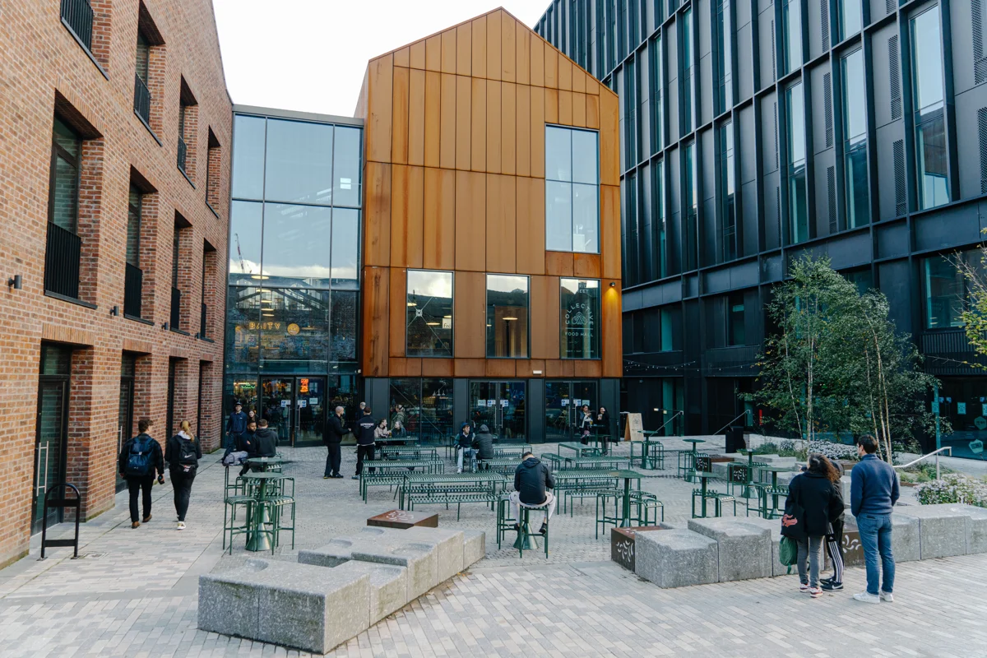



Sheffield is a student friendly city with plenty of affordable cafes and restaurants.
Food
Average cost for uk student food shop - £144 per month
(SaveTheStudent.Org, 2024)
Cambridge Street Collective, opened in 2023

Slide 11
Mythbusting Student Finance Repayments
You won’t have to make repayments until your income is over the set threshold of £25,000
Your repayments will be taken automatically from your payslip
You will be required to start repaying from the April after completing your course
If your income drops below the threshold, your repayments stop
Any outstanding balance is cancelled after 40 years of completing your course.

Slide 12
Student Finance England: Application Timeline
MARCH
MAY
SEPTEMBER
Applications Open
Deadline
Enrol at University

Slide 13







Managing your money
Managing Your Money: Before University
Managing Your Money: At University
Prepare to bring money with you!
Shop around for student bank accounts.
Part time opportunities.
Remember your maintenance loan is paid in three instalments
Blackbullion.com is a useful website for tips and advice on spending and saving while you’re at university.

Slide 14


Hallam Bursaries and Scholarships
Extra sources of financial support are available in the form of university-specific scholarships and bursaries.
Unlike student loans, typically you don’t have to pay these back.
Student Success Scholarships
Care Leaver Bursary
Placement Bursary
Performance Athlete Support Programme

Slide 15


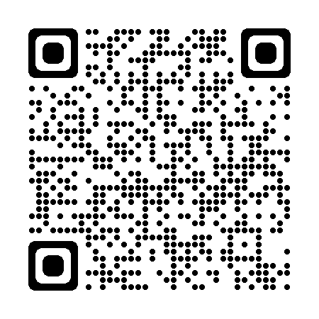


c
Government Grants Available
Parents Learning Allowance
Disabled Students Allowance​ (DSA)
You can apply for DSA from Student Finance England before you start your course. This is applied to separately from your maintenance/tuition fee loan.
Disclosure​
Disclosing a disability on your application does not impact the outcome. It is only asked so support can be recommended to you.
It can take up to three months to get your DSA support in place so you should apply for it as soon as you have applied for a course.
Adult Dependant Grant
Childcare
Grant

Slide 16

Join us at an Open Day!
Notes:
WEBINAR + OPEN DAYS

Slide 17

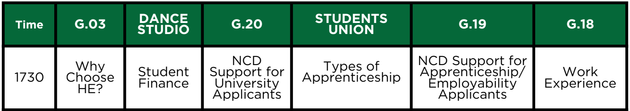
Thank you
The slides from this talk will be posted on our college website – we’ll text out a link when they’re available to view
Other talks available this evening
Don’t forget to visit out university and employer fair in the Sports Hall
Our visitors are available until 7.30 pm
1730
1800
1830
1900
1830 only

