Slide 1







Beyond the Classroom
Post-18 progression routes

Slide 2
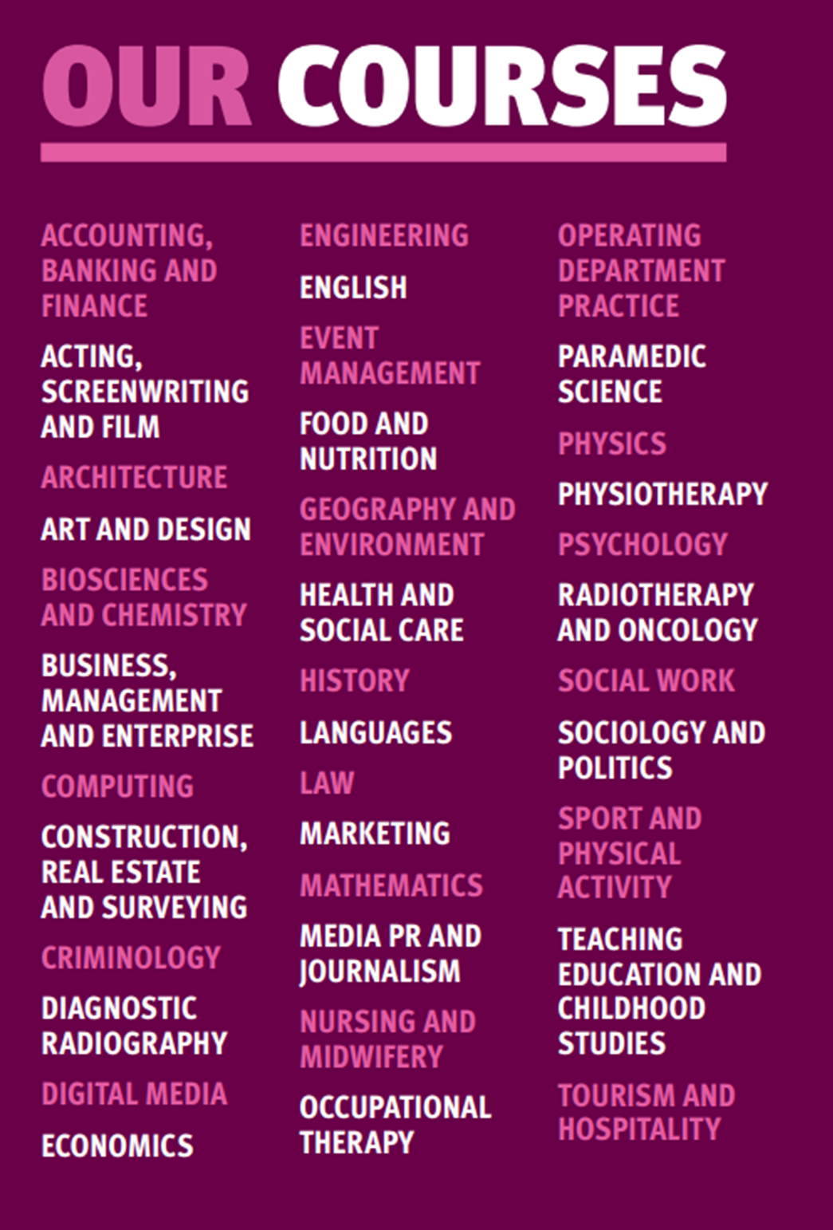
WHAT CAN YOU STUDY?
We offer a wide range of undergraduate courses across dozens of subjects, as well as foundation years and degree apprenticeships.
In fact, our degree apprenticeship portfolio is one of the widest in the country!
Popular subjects include psychology, computing, business and law.
Notes:
*ASK AO’S TO CHIP IN*

Slide 3
SO MUCH CHOICE!
How many degree courses are currently available within the UK?
50,000+
There are two approaches when it comes to deciding...
Notes:
There are almost 300 different HE institutions with around 50,000 different course options – great to have choice but makes the decision making process even harder.

Slide 4
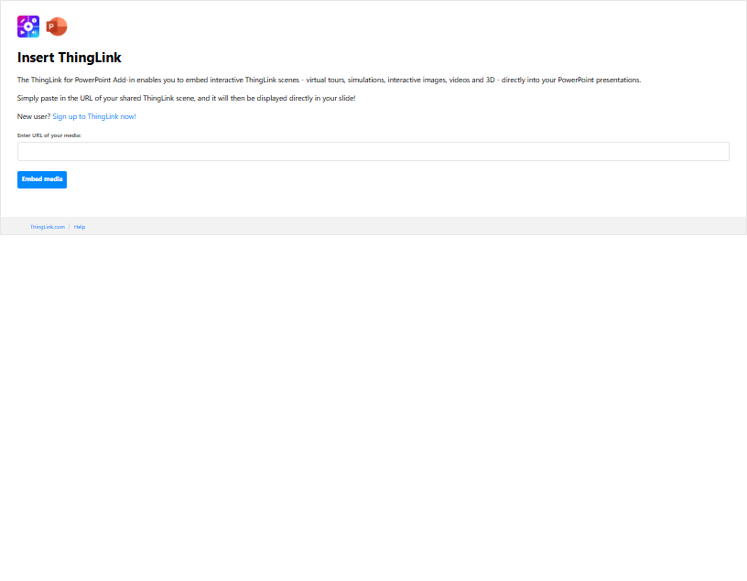
What are my HE choices?
It’s good to research into different options into HE before making a decision!
Notes:
Go over picking which route to go into as university is not the only option.

Slide 5
What are my HE choices?
Undergraduate degree
Specific subject area
3/ 4 years long
Student Finance available
Placement years available
Apply through UCAS
Notes:
Discuss information about an undergraduate course of being the “traditional” route that majority of students associate with HE.

Slide 6
What are my HE choices?
Foundation Year (Level 3-4 – depending on the course)
An extra year at the start of an undergraduate degree.
Offers a great starting point if you don’t quite meet the entry requirements for a degree.
Typically takes 1 year to complete – followed by a 3-year degree
Foundation Degrees (Level 5)
A standalone vocational qualification that combines academic study with practical skills.
Designed with employers to prepare students for specific careers. Can be “topped up” to a full undergraduate degree with an extra year.
Typically 2 years to complete
Notes:
Discuss information about FY and FD – this might be popular for those that either don’t quite get the grades or just aren’t ready to commit to the full 3-4 years of an undergraduate degree.

Slide 7
University Application Timeline
Summer of Y12
Research options, courses & universities
Nov/Dec
School & College internal deadlines
March
Student Finance opens / Accommodation applications
August
Results Day / Confirmation / Clearing
Start of Y13
Begin UCAS application
January
Equal Consideration Deadline
NOTE: Some courses and institutions have earlier deadlines!
May
Respond to offers
September
University courses start
Notes:
Worth noting the early application deadline in October for Medicine/Veterinary/Dentistry/Oxbridge courses.

Slide 8

WHICH INSTITUTION?
With almost 300 registered HE institutions in the UK,
how do you pick the right one? ​
Consider the following:
Distance from home
Accommodation or commuting
Campus or City institution
Opportunities and facilities

Slide 9

WHICH COURSE?
There are currently over 50,000 courses available in the UK!
Consider the following when deciding which course to pick:
Course title
How you learn
Careers
Facilities
Entry requirements
Modules

Slide 10

What are my HE choices?
Degree Apprenticeship
3 - 6 years (varies)
80% work based - 20% HE institution
Employer covers cost of training
Earn a wage (no student finance entitlement)
Apply directly to the employer, not through UCAS
Notes:
Discuss information about DAs– this slide highlights the basics of DA’s but also let them know some facts like in 2022/23 only a minority (13%) of level 6 starters were age 18 (and so leaving full-time education). Degree apprenticeships - House of Commons Library. So they have a realistic approach of getting onto a DA.

Slide 11

Apprenticeship Levels
Level 2
GCSE equivalent. Roles such as junior estate agent & finance assistant.
Level 3
A-Level equivalent. Roles such as chef, IT technician, fashion assistant.
Level 4-5
Foundation degree equivalent. Roles such as clinical dental technician & data analyst.
Level 6-7
Degree level equivalent. Roles such as aerospace engineer, ecologist, accountant.
Notes:
Any qualification you can study can be mapped onto different levels. Level 2 = GCSE equivalent, Level 3 = A Levels, Level 4-5 = foundation degree. Level 6 & 7 = degree level equivalent. Importantly when you’re looking for DA vacancies, you should look for Level 6. Level 6 is equivalent to an undergrad course, whilst Level 7 is masters. The level of apprenticeship will always be listed on the job advert.

Slide 12

Degree Apprenticeships at Sheffield Hallam University

Slide 13
Degree Apprenticeships: Advantages & Disadvantages
On-the-job training – learn practically
Earn while you learn – starting salaries on average £18,000
Upskill for free - no student loan, employer covers the cost
Kickstart your career – and retain your job after finishing your degree
Flexible way to learn, through a blend of practice and theory
Notes:
Run through the above points, elaborating on any points you’d like.

Slide 14
Degree Apprenticeships: Advantages & Disadvantages
Competitive – limited vacancies and anyone over 18 can apply.
Demanding – work must be balancing along study.
A-typical uni experience – limited access to traditional student life.
Financial implications – no student loan entitlement, consideration of living / commuting / housing costs needed.
Notes:
Stress that DAs aren’t a perfect route – they are very competitive and demanding, with far fewer vacancies compared to tradition undergrad routes. Students can use uni facilities; however, their uni experience will look very different. Whilst having no student ‘debt’ sounds attractive, there are financial considerations e.g., making your (relatively lower) apprentice salary stretch to cover your costs e.g., commuting.

Slide 15



Applying for degree apprenticeship vacancies
How do I apply?
Directly to the employer - CV, cover letter, interview. Vacancies can go live at any time.
What are the entry criteria?
Varies by employer, but tracks in line with typical degree courses - (112-128 UCAS points).
When do apprenticeships start?
Depends on the company – no fixed start date. DAs are typically 3 years in length – but can be longer.
Notes:
When you’re applying for, or considering applying for a degree apprenticeship, there are a couple of things to note. As we’ve mentioned earlier, the application process for a degree apprenticeship is different to applying for university: rather than applying through UCAS, you apply directly to employer for a DA vacancy. You should also apply with whatever the employer requires at the time of application – e.g., a CV, a covering letter, sometimes there’s an assessment centre of an interview. Consider each application on a case-by-case basis, one application per vacancy. In terms of the entry criteria, this is tricky because again, it depends on the vacancy and employer. However typically, we see vacancies between 112-128 UCAS points (BBC-ABB), as well as passes (5s) and above at GCSE. Again, some vacancies may be higher than this, so consider each application on a case-by-case basis. Lastly in terms of when apprenticeships start, again this depends on the company. However, most employers know that you as school leavers will be available from September onwards. DAs typically track similarly to undergrad courses in terms of length, but do sometimes exceed 3 years, so it’s a case of checking the job advert carefully as this information will be listed.

Slide 16

Join us at an Open Day!
Notes:
WEBINAR + OPEN DAYS

Slide 17


Slide 18

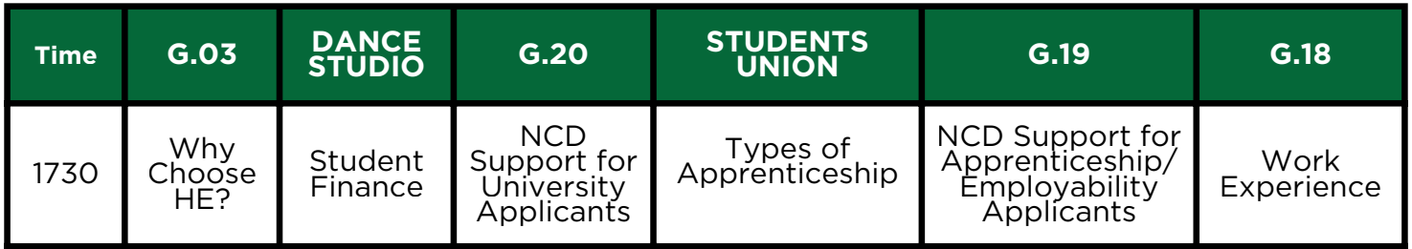
Thank you
The slides from this talk will be posted on our college website – we’ll text out a link when they’re available to view
Other talks available this evening
Don’t forget to visit out university and employer fair in the Sports Hall
Our visitors are available until 7.30 pm
1730
1800
1830
1900
1830 only

