Slide 1

Welcome
How does New College support students with Work Experience?

Slide 2

Why we encourage work experience
New College encourages all students to participate in Work Experience.
For some students applying for certain university courses it is a requirement
Work experience maybe required as part of their college course
For others it is a chance to gain an insight into a future career.

Slide 3
Why we encourage work experience
Work experience will provide students with the opportunity to put the skills and theories they have learnt in college into real life situations.

Slide 4
Benefits of a work experience placement
Help students gain an insight to a career
Hands on experience
Build confidence
Experience skills such as teamwork within a professional setting
Excellent for CV and UCAS applications

Slide 5
Ways to find a placement
Students are encouraged to find work placements independently.
Students are always recommended to speak to family/friends to seek out relevant placements
Do you have a part time job? Does the organisation have different departments you could explore?
Think outside the box:
- companies that practice law are not always law firms etc.
- schools can also offer sport placements not just teaching
- could you do some volunteering?

Slide 6

How we support students with finding work experience
All students are supported before, during and after their placement.
Ways which we support students finding a placement:
Student meetings – 1-2-1 meetings to discuss suitable employers and ways to make contact.
Work experience page – updated with schemes / virtual placements
Tutorial information – talks with students regarding processes and opportunities
Work Experience enrichment sessions at the start of the academic year

Slide 7















Examples of Employers we work with
Over the years we have built up a range of employers who we work with from various sectors.

Slide 8




Virtual work experience
Being in Doncaster it is not always possible to get the exact experience you are looking for, however virtual work experience aims to bridge that gap.
Some employers offer their own virtual experience
There are also sites that offer a variety of options

Slide 9

When students can complete work experience
All students have the opportunity to attend work experience for up to 2 weeks during college hours
Important dates:
1st – 5th June: Work placement week for triple sport students
22nd – 26th June: Work placement week for Health and Social care, Childcare and UPS students
2nd July: Work placement day
All work placements during college hours need to be authorised by Progress Tutors and teachers

Slide 10

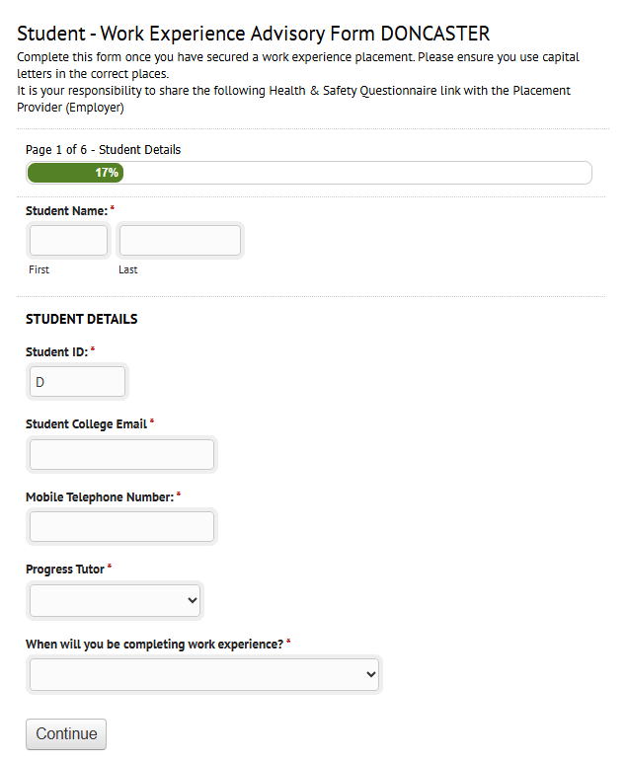
How we authorise work placements
All students wanting to attend a work placement need to complete our advisory form.
Students cannot attend within college hours until they have completed the form and we have authorised the placement. We can then in turn authorise the absence from college.
Parents will receive a text once paperwork is complete to advise about the placement.

Slide 11
Are you able to help a student with a work placement?
We are always looking for employers that can accommodate students for work experience.
How can I help?
Does your company have Employer Liability Insurance?
Do you have a Corporate Social Responsibility Policy (CSR)?
- This can be a great way to tick some boxes!
Students can offer fresh perspectives and energy
- i.e. marketing and social - media

Slide 12

Are you able to help a student with a work placement?
If you have any capacity to support a student with a work placement we would love to hear from you!

Slide 13
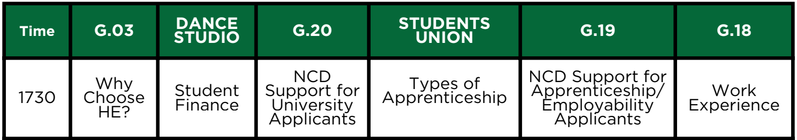
Thank you
The slides from this talk will be posted on our college website – we’ll text out a link when they’re available to view
Other talks available this evening
Don’t forget to visit out university and employer fair in the Sports Hall
Our visitors are available until 7.30 pm
1730
1800
1830
1900
1830 only

